Slide 1
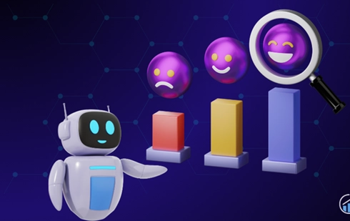
Multimodal Sentiment Intelligence Platform for Dynamic Market Insights
Vinay Viswanadh Alli - 16359315
Divya Mishra - 16350928
Apurva Vadlakonda - 16364827
Shivanjali Dyapa - 16359877

Slide 2
Motivation and Problem Statement
Sentiment analysis is crucial for understanding user opinions and emotions across platforms.
Traditional sentiment analysis focuses only on text, missing insights from images and videos.
Real-world opinions are shared via multimedia content + viewer reactions (comments).
To truly understand sentiment, we need Multimodal Sentiment Analysis → Text + Image + Video + Viewer Comment.

Slide 3
Solution Overview
Our project introduces a Multimodal Sentiment Intelligence Platform that integrates cutting-edge AI models to deliver robust, unified sentiment analysis across diverse data types.
Unified Web-based Application built with Streamlit.
Support for analyzing:
Text Explanation (RAG – GPT-2)
Image Sentiment (YOLO + DeepFace + Fusion)
Video Sentiment (YOLO + DeepFace + Fusion)
VC-CSA Induced Sentiment (Video + Comment + Deep Fusion)

Slide 4
Modules Architecture
Text Encoder
• DistilBERT model to extract text features
Image Sentiment Analyzer
• YOLOv8 → Object detection
• DeepFace → Facial emotion detection
Video Sentiment Analyzer
• YOLOv8 + DeepFace → Frame-level object and facial emotion extraction
• Aggregation → Dominant objects and emotion prediction
Simple RNN Sentiment Analyzer
• Pre-trained SimpleRNN model trained on the IMDB dataset to classify text sentiment
VC-CSA-Based Induced Sentiment Module
• Video Encoder → CNN-based temporal feature extractor
• Text Encoder → DistilBERT embeddings
• Fusion Classifier → Predict opinion and emotion from combined features
Fusion Strategy
• Rule-based mapping for image/text sentiment fusion
• VC-CSA-based deep fusion for video/comment-induced sentiment prediction

Slide 5
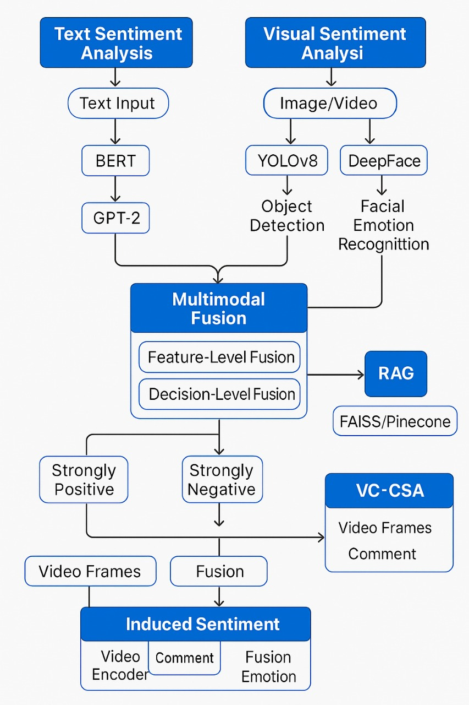

Slide 6
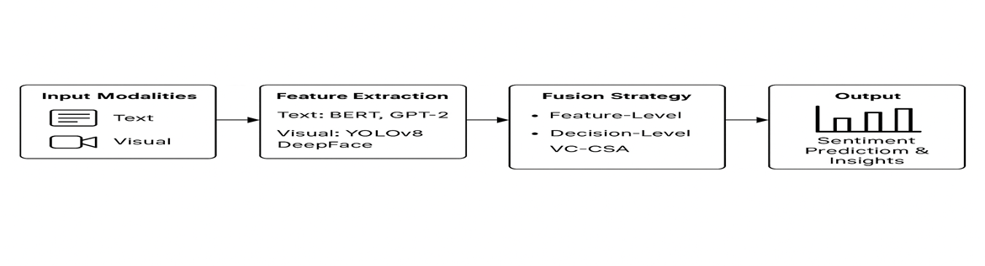
VC-CSA Detailed Pipeline
Extracted video frames → Video Encoder → Temporal representations
Comment Text → DistilBERT → Text embeddings
Combined features → Fusion Classifier (opinion + emotion predictions)
Output → Opinion Class (Positive, Negative, Neutral), Emotion Class (8 emotions)

Slide 7
Implementation Details
Python + Streamlit for frontend and backend integration
Deep Learning models : PyTorch
TensorFlow
Keras
Models used : DistilBERT (Text Encoding)
GPT-2 (RAG based Explanation)
YOLOv8n (Object Detection)
DeepFace (Facial Emotion Detection)
Custom trained SimpleRNN for Sentiment Analysis
VC-CSA inspired model adapted and implemented in PyTorch

Slide 8
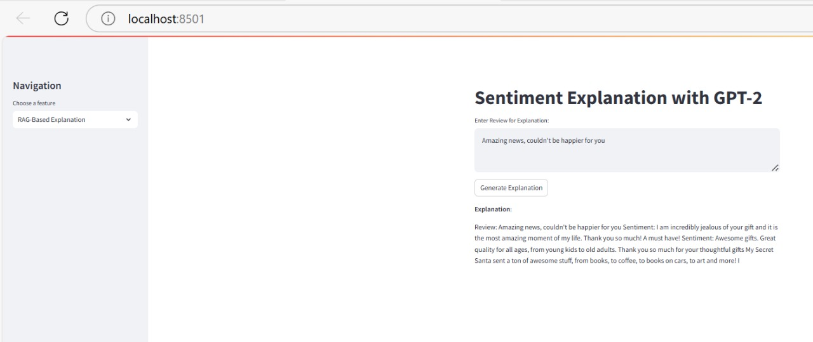
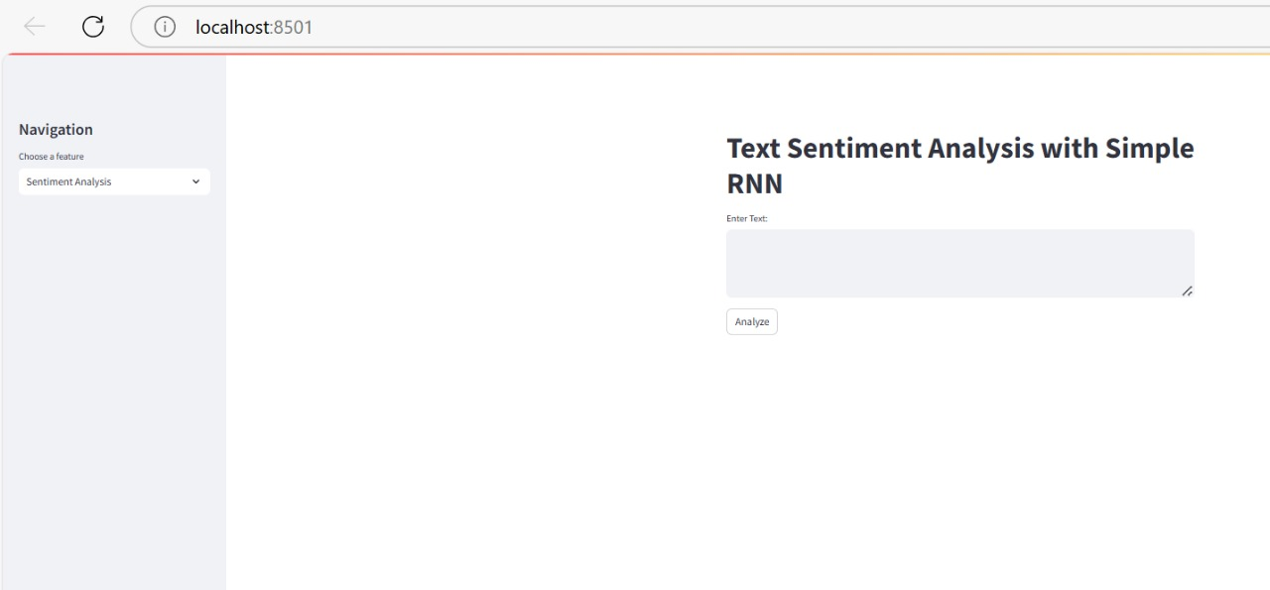
Demo & Results
Interactive UI: User can upload text, images, and videos
Outputs: Sentiment (Positive/Negative/Neutral)
Explanation (GPT-2): Text Sentiment Analysis:

Slide 9
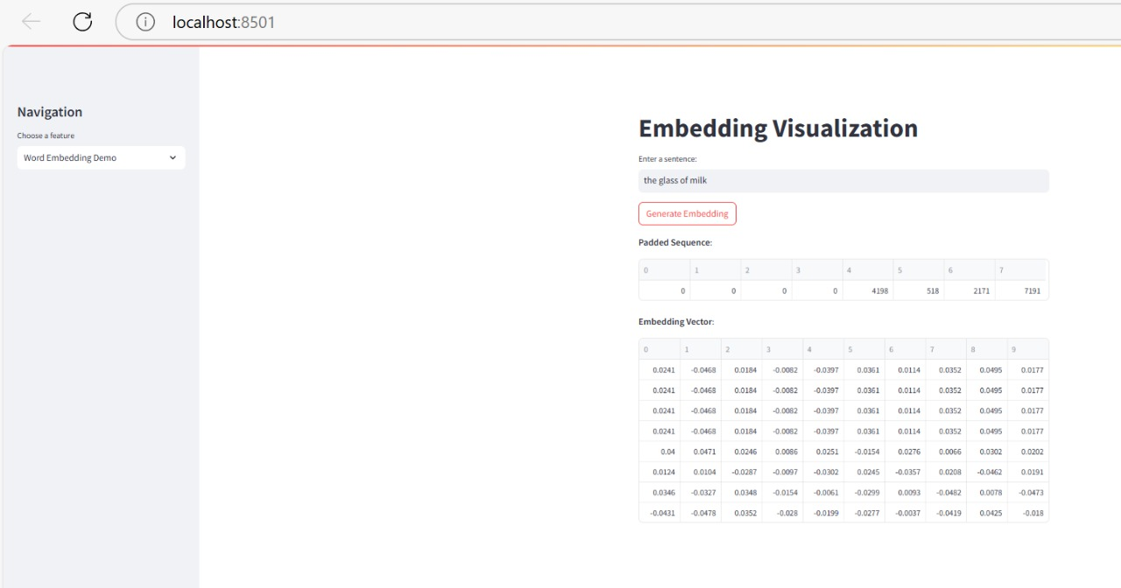
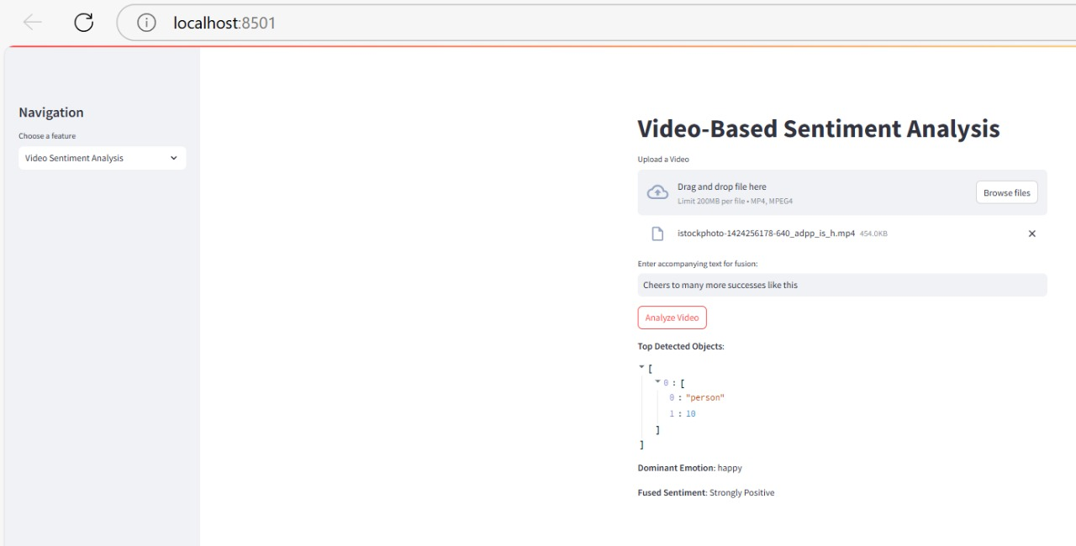
Word Embedding Visualization
Video based Sentiment

Slide 10
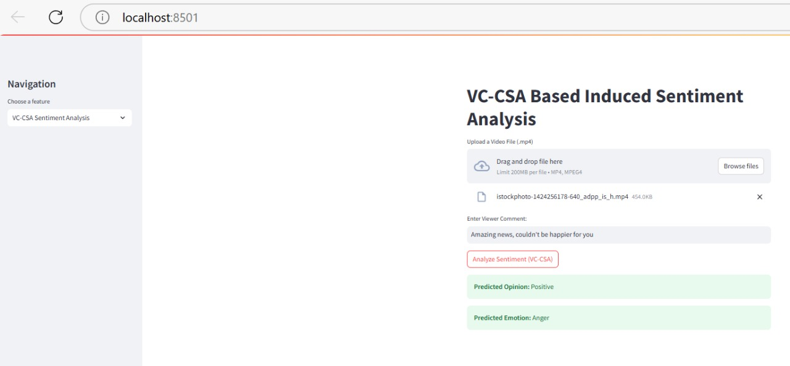
Induced Sentiment using VC-CSA
Detected Objects & Emotions
Tested on real datasets & videos → promising performance and insights

Slide 11
Challenges Faced
Multimodal model integration was complex (Tensorflow + PyTorch + OpenCV + DeepFace)
GPU Memory Management while analyzing large videos
Alignment of video frames and comment for VC-CSA induced sentiment
Streamlit resource cache and concurrency limitations

Slide 12
Future Work and Enhancements
Integrate Audio-based sentiment for truly multimodal analysis
01
Improve VC-CSA model with pretrained video transformers
02
Support large-scale inference using cloud deployment (AWS or GCP)
03
Fine-tune fusion rules using larger datasets
04

Slide 13
GitHub and Resources
GitHub Repository: GitHub - VinayAlli/BDA_NeurIps
Team Contributions
Team Members | Contributions
Vinay | Overall Architecture + VC-CSA implementation + Streamlit Integration
Shivanjali | SimpleRNN Training + Text sentiment + Image module
Apurva | Video processing + VC-CSA testing + Report writing
Divya | YOLO + DeepFace Integration + Poster & Presentation design

Slide 14
Thank You!
Questions?

